Slide 1
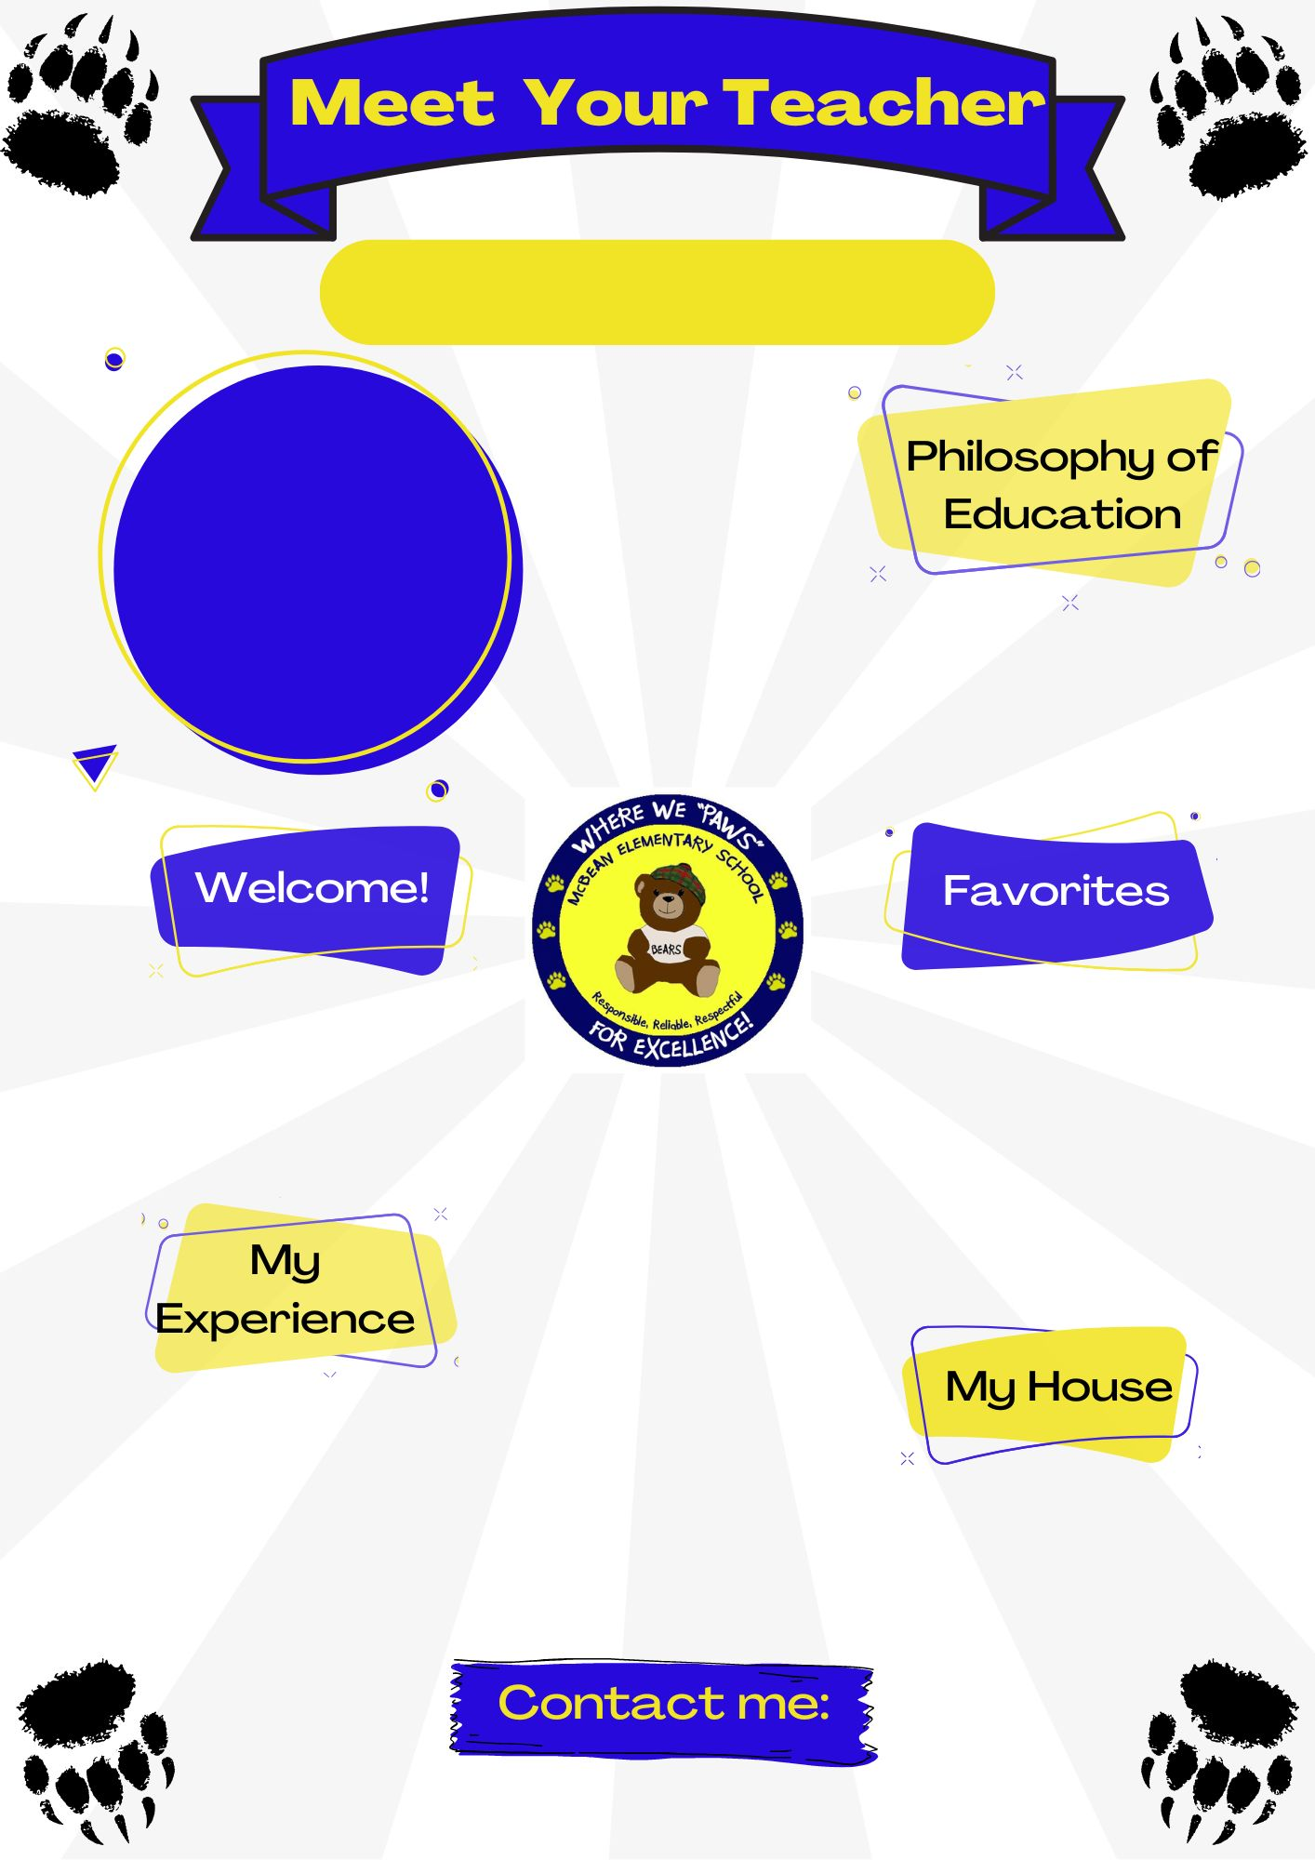
Mrs. Goff
Insert picure here
Special Education Teacher
Every student can show progress regardless of his or her disability.
Hello there! I am so excited to be here with you all this year. Let’s go Bears!
Color(s): glitter
Animal(s): dog
Hobby: running & biking
Sport: soccer
Book: Twilight
Movie: Beauty and the Beast
Food: salt & vinegar chips
Drink: coffee
This is my 10th year of working in education. I graduated from Valdosta State University with a Bachelor of Science in Education degree.
GoffSh@richmond.k12.ga.us

